Slide 1

WriteFlow - Introduction
WriteFlow is innovating text editing and Productivity. Our state-of-the-art notepad design creates a seamless writing experience. We help users enhance their productivity and creativity. We offer the best features for writers and developers.
A
by SK Ashiful Haque

Slide 2

Our Mission & Vision
Mission
To empower users with advanced writing tools that are accessible and efficient.
Vision
To set the standard for modern, intuitive, and feature-rich text editors globally.

Slide 3
WriteFlow - Our Journey
2023: Conceptualized
2025: Feature Expansion
WriteFlow was born from the idea of creating a versatile, user-friendly notepad.
Introduced advanced features like dark mode, find and replace, and code execution.
1
2
3
2024: Initial Launch
We Released the first version of WriteFlow, gaining positive feedback for its simplicity and functionality.

Slide 4



Solving Problems with Innovation
Advanced Editing Tools
Programming-Friendly
Enhanced Usability
Gain deep Enjoy seamless test editing with features like undo/redo, zoom, and customizable options.
Execute code directly within WriteFlow, making it ideal for developers.
Dark mode, line numbers, and print options enhance user experience for diverse needs.

Slide 5

Meet the Team
SK Ashiful Haque, Developer
Innovative thinker and creator of WriteFlow. Passionate about software development and productivity tools.

Slide 6
By The Numbers
1000+
98%
40%
Satisfied Users
User Satisfaction
Feature Expansion Rate
Rapidly growing community of writers and developers.
We ensure high quality and usability.
Constant updates to keep WriteFlow ahead of the curve.

Slide 7

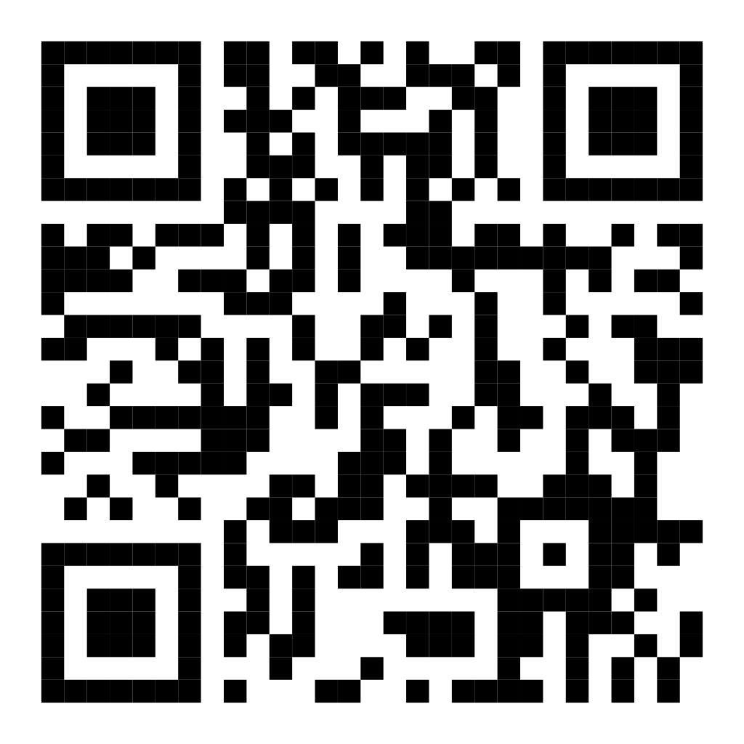
Let's Connect
Visit our website to learn more about WriteFlow or schedule a demo to explore its features.
Website: https://skashiful.github.io/WriteFlow/
Email: skashiful1234@gmail.com
Phone: +91 7074390931

